Slide 1
Exception Handling

Slide 2
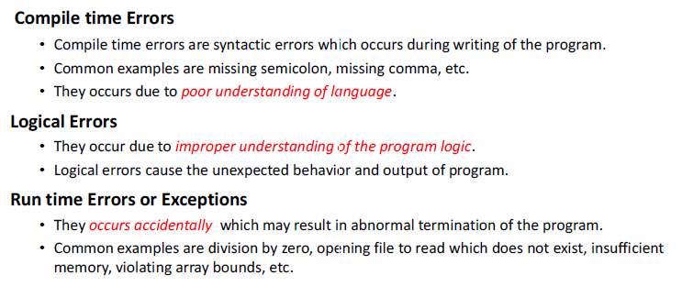
Errors

Slide 3
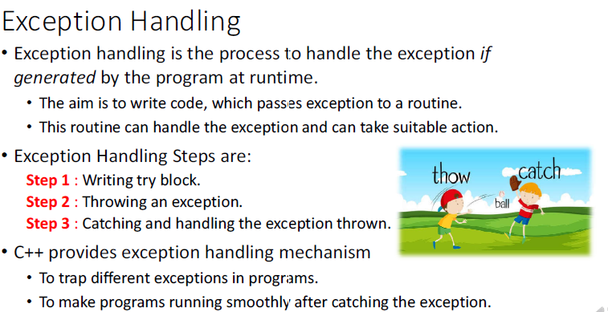

Slide 4
Exception Handling
One of the advantages of C++ over C is Exception Handling. Exceptions are run-time anomalies or abnormal conditions that a program encounters during its execution. There are two types of exceptions:
Synchronous,
Asynchronous (Ex:which are beyond the program’s control, Disc failure etc).
C++ provides following specialized keywords for this purpose. try: represents a block of code that can throw an exception. catch: represents a block of code that is executed when a particular exception is thrown. throw: Used to throw an exception. Also used to list the exceptions that a function throws, but doesn’t handle itself.

Slide 5
Exception Handling
#include <iostream>
using namespace std;
int main()
{
int x = -1;
cout << "Before try \n";
try {
cout << "Inside try \n";
if (x < 0)
{
throw x;
cout << "After throw (Never executed) \n";
}
}
catch (int x ) {
cout << "Exception Caught \n";
}
cout << "After catch (Will be executed) \n";
return 0;
}
Before try
Inside try
Exception Caught
After catch (Will be executed)

Slide 6
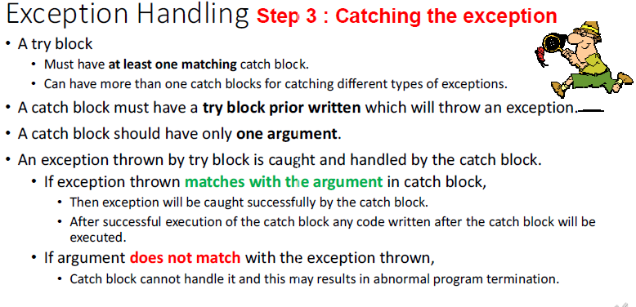

Slide 7
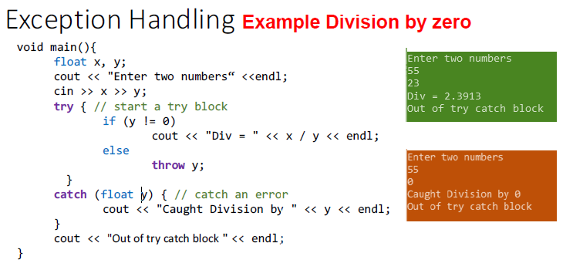

Slide 8
Exception Handling
There is a special catch block called ‘catch all’ catch(…) that can be used to catch all types of exceptions. For example, in the following program, an int is thrown as an exception, but there is no catch block for int, so catch(…) block will be executed.
#include <iostream>
using namespace std;
int main()
{
try {
throw 10;
}
catch (char excp) {
cout << "Caught " << excp;
}
catch (...) {
cout << "Default Exception\n";
}
return 0;
}

Slide 9
Exception Handling
If an exception is thrown and not caught anywhere, the program terminates abnormally. For example, in the following program, a char is thrown, but there is no catch block to catch a char.
#include <iostream>
using namespace std;
int main()
{
try {
throw 'a';
}
catch (int x) {
cout << "Caught ";
}
return 0;
}
Output:
terminate called after throwing an instance of 'char’.
This application has requested the Runtime to terminate it in an unusual way. Please contact the application's support team for more information.

Slide 10
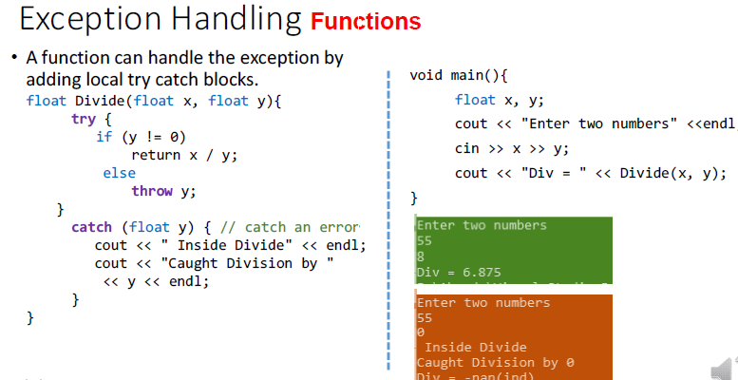

Slide 11
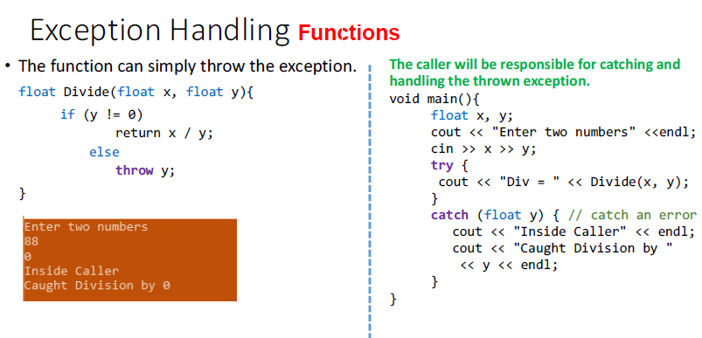

Slide 12
void fun(int *ptr, int x)
{
if (ptr == NULL)
throw ptr;
if (x == 0)
throw x;
/* Some functionality */
}
int main()
{
try {
fun(NULL, 0);
}
catch(...) {
cout << "Caught exception from fun()";
}
return 0;
}

Slide 13
Exception in classes
#include <iostream>
using namespace std;
class Test {
public:
Test() { cout << "Constructor of Test " << endl; }
~Test() { cout << "Destructor of Test " << endl; }
};
int main()
{
try {
Test t1;
throw 10;
}
catch (int i) {
cout << "Caught " << i << endl;
}
}
When an exception is thrown, all objects created inside the enclosing try block are destructed before the control is transferred to catch block.
Constructor of Test
Destructor of Test
Caught 10

Slide 14
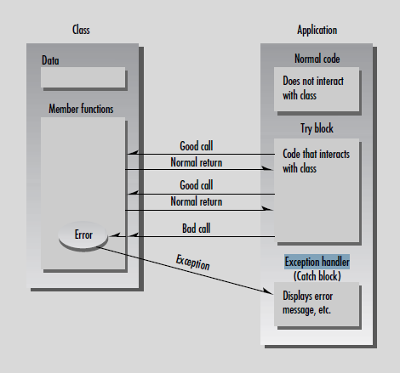
Exception Handling

Slide 15
Exception in classes
class Base {
};
class Derived : public Base {
};
int main()
{
Derived d;
// Some other functionalities
try {
throw d;
}
catch (Derived d) {
cout << "Caught Derived Exception";
}
catch (Base b) {
cout << "Caught Base Exception";
}
getchar();
return 0;
}
Always write derived class catch before base catch.

Slide 16
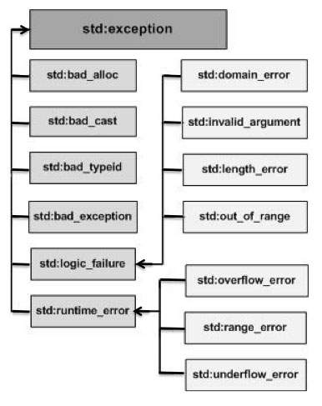
C++ standard exception
1 | exception An exception and parent class of all the standard C++ exceptions.
2 | bad_alloc This can be thrown by new.
3 | bad_cast This can be thrown by dynamic_cast.
4 | bad_exception This is useful device to handle unexpected exceptions in a C++ program.
5 | bad_typeid This can be thrown by typeid.
6 | logic_error An exception that theoretically can be detected by reading the code.
7 | domain_error This is an exception thrown when a mathematically invalid domain is used.
8 | invalid_argument This is thrown due to invalid arguments.

Slide 17
C++ standard exception
9 | length_error This is thrown when a too big string is created.
10 | out_of_range This can be thrown by the 'at' method, for example a vector and bitset<>::operator[]().
11 | runtime_error An exception that theoretically cannot be detected by reading the code.
12 | overflow_error This is thrown if a mathematical overflow occurs.
13 | range_error This is occurred when you try to store a value which is out of range.
14 | underflow_error This is thrown if a mathematical underflow occurs.

Slide 18
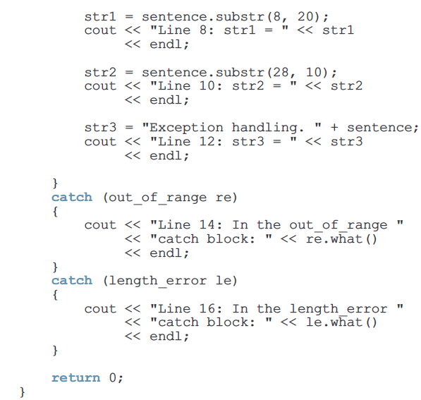
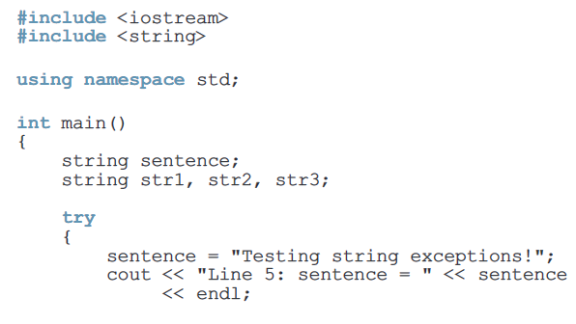
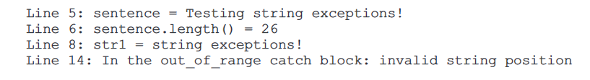
Out of range and length error

Slide 19
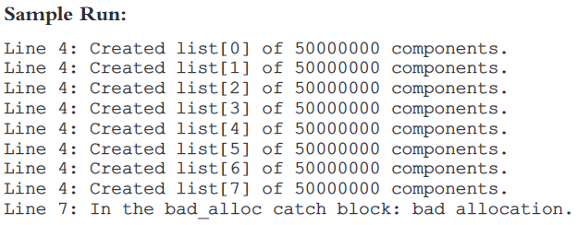
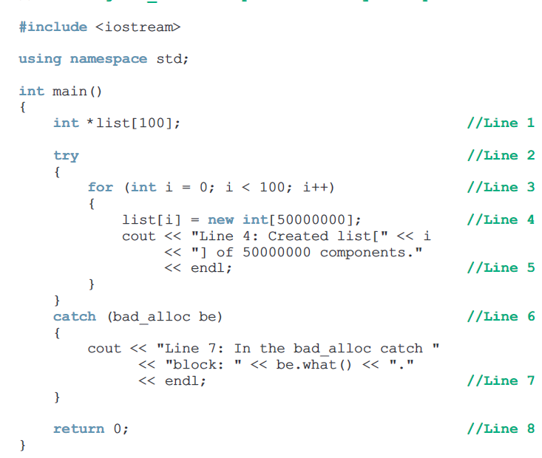
Bad alloc

Slide 20
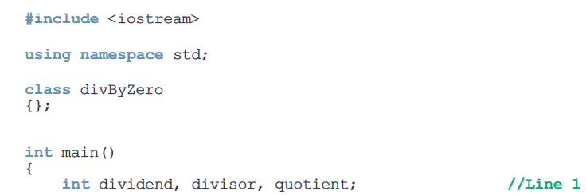
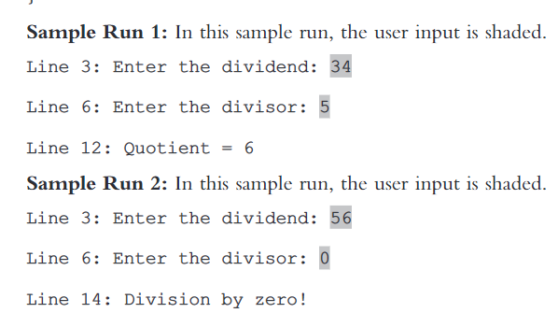
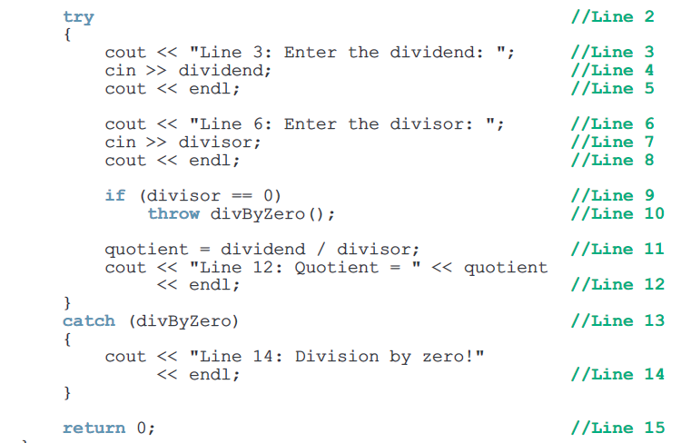
User define exception class

Slide 21
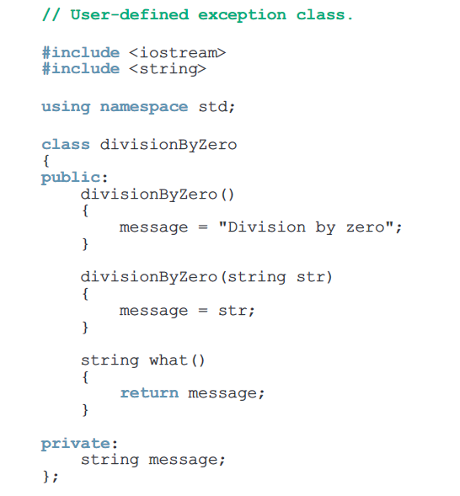
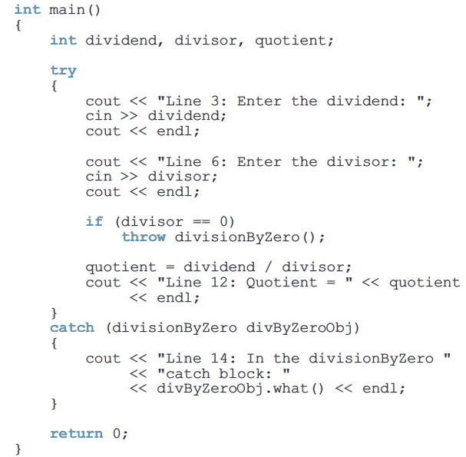
User define exception class

Slide 22
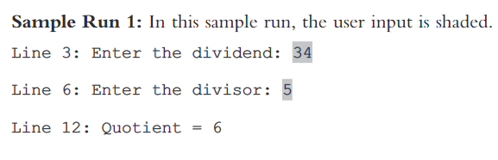

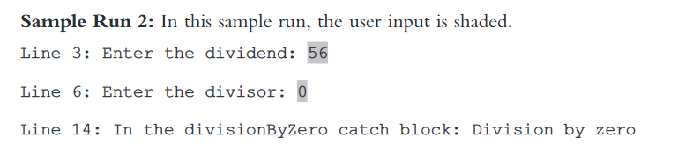
User define exception class

Slide 23
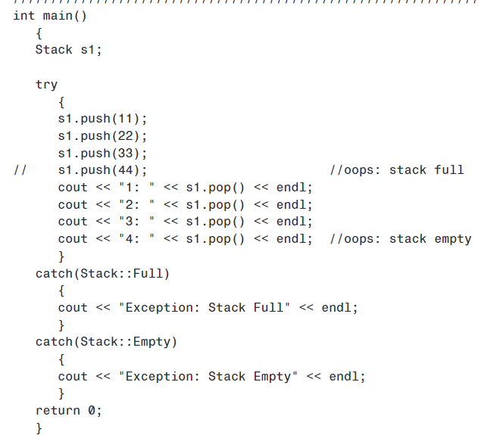
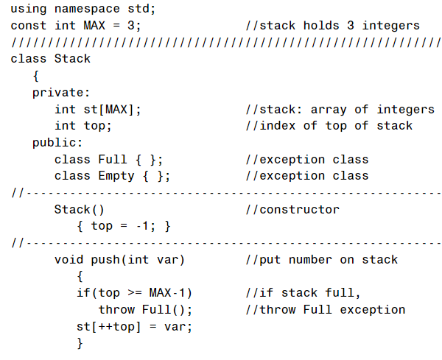
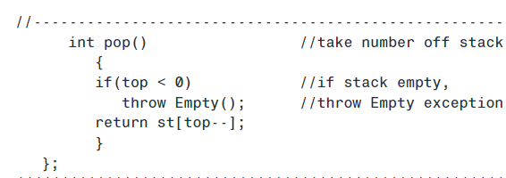
Multiple Exceptions by making own classes

Slide 24
Throw and rethrow
#include <iostream> using namespace std; void MyHandler() { try { throw “hello”; } catch (const char*) { cout <<”Caught exception inside MyHandler\n”; throw; //rethrow char* out of function } } int main() { cout<< “Main start”; try { MyHandler(); } catch(const char*) { cout <<”Caught exception inside Main\n”; } cout << “Main end”; return 0; }
Output :Main start Caught exception inside MyHandler Caught exception inside Main Main end

Slide 25
Throw and rethrow
class Base
{
public:
Base() {}
virtual void print() {cout << "Base"; }
};
class Derived: public Base
{
public:
Derived() {}
void print() override { cout << "Derived"; }
};
int main()
{
try
{
try
{
throw Derived{};
}
catch (Base& b)
{
cout << "Caught Base b, which is actually a ";
b.print(); cout << "\n";
throw;
}
}
catch (Base& b)
{
cout << "Caught Base b, which is actually a ";
b.print();
cout << "\n";
}
}
Output :Caught Base b, which is actually a Derived
Caught Base b, which is actually a Derived

Slide 26

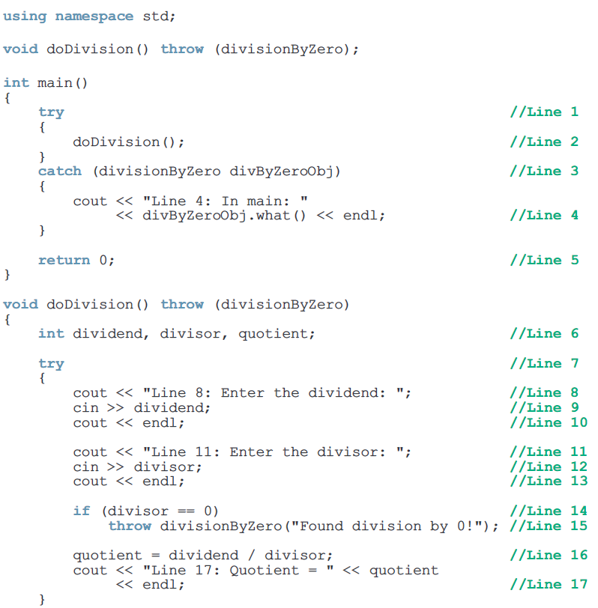
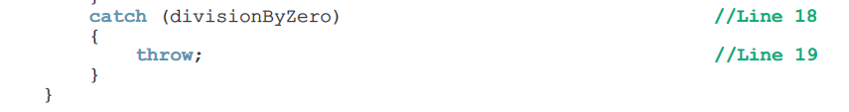
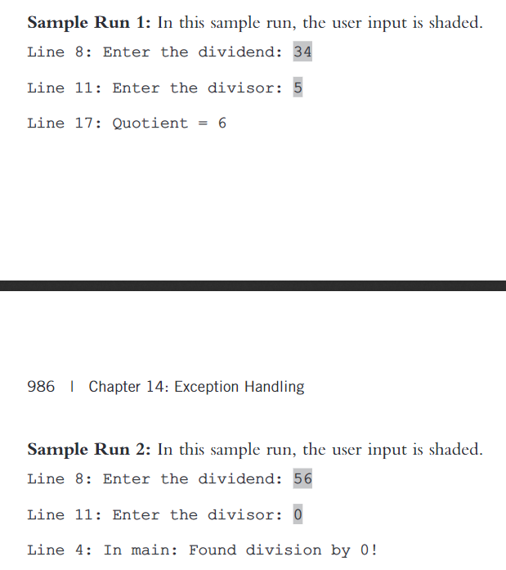
Throw and rethrow

